Slide 1
Substitution models week 36 recap + paper discussion

Slide 2




Primate of the Week
Bonobo
Pan Paniscus
Hippie of the great apes
Make love not war

Slide 3
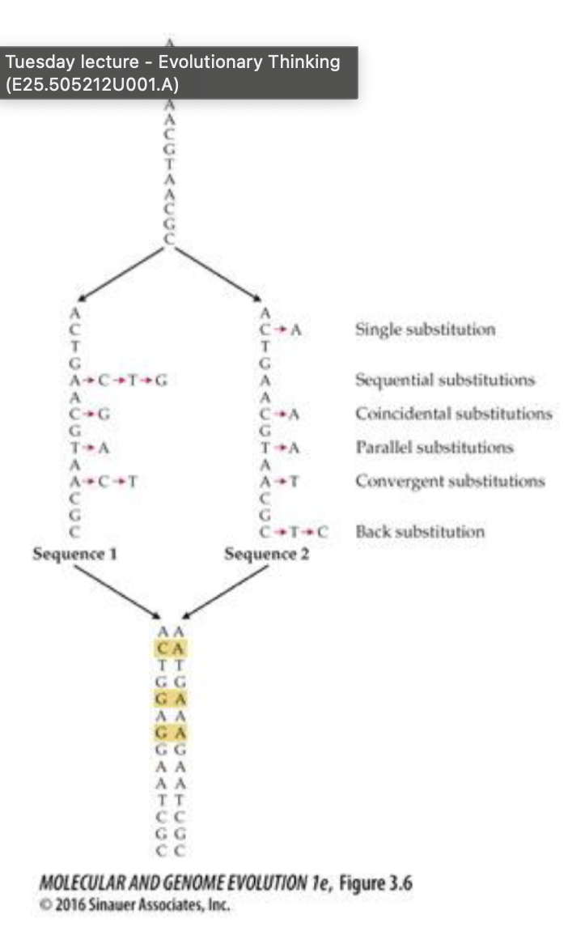
Nucleotide substitutions
Divergent sequences
AGATGCTAGCATCGACTAGCARCAGCTGACCCGCGCGCGCAT
AGATAATAGCATCGACTAGCARCAGCGGACCCGCGCGCGCAC
Different substitution models to explain this

Slide 4
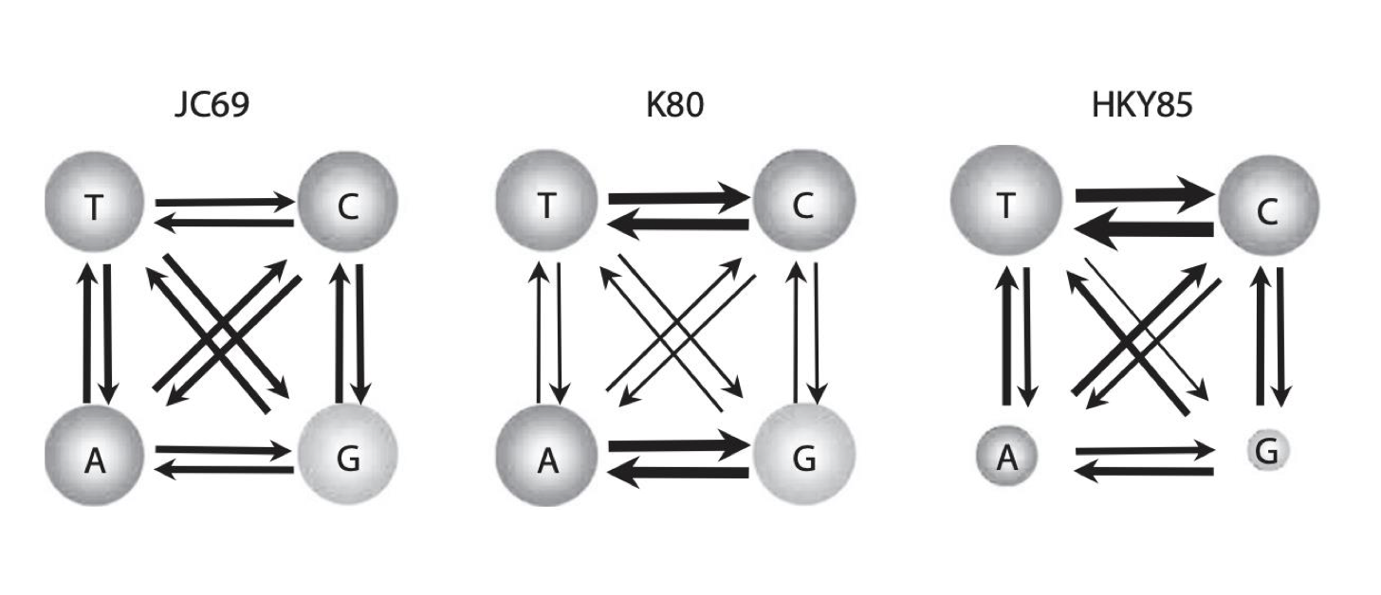
Substitution models
D-estimation -> proportion of nucleotide sites that differ
Jukes-Cantor -> corrects for multiple & reverse changes
+ separate rates for transition (A<-> G or C<->T) and transversions
Kimura’s 2 parameter model
+ Different equilibrium frequency distribution
HKY85
+ variability among sites
*Model* + Gamma

Slide 5
Substitution models
+ Gamma
+G
Variation in substation rates across sequence
Felsenstein 81
F81
Different equilibrium frequency for each nucleotide
Jukes-Cantor 69
JC69
Hasegawa 1985
HKY85
Single rate of substitutions
Different equilibrium frequency distribution AND unequal transition and transversion rates
Tamura and Nei 1993
TN93
Different equilibrium frequency distribution AND unequal transition and transversion rates for pyrimidines and purines
Kimura 80
K80
Separate rates for transitions and transversions
Notes:
Gamma distribution -> Variation in substitution rates across sequence

Slide 6
Different methods – phylogenetic trees
Distance method
UPGMA
Neighbor joning
Parsimony method
Maximum parsimony
Likelihood method

Slide 7
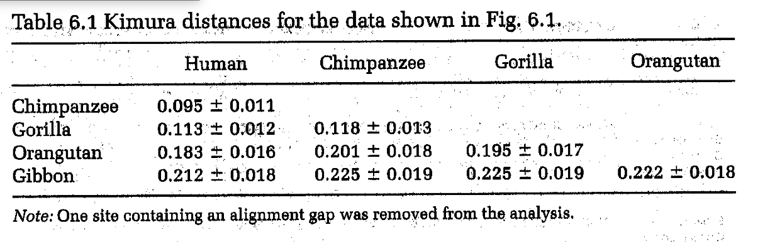
Order to build phylogenetic tree
Fit nucleotide substitution model
Calculate distance matrix under the model
Build phylogenetic tree based on distance matrix
Nucleotide sequences
Aligned Sequences
What kind of tree?

Slide 8
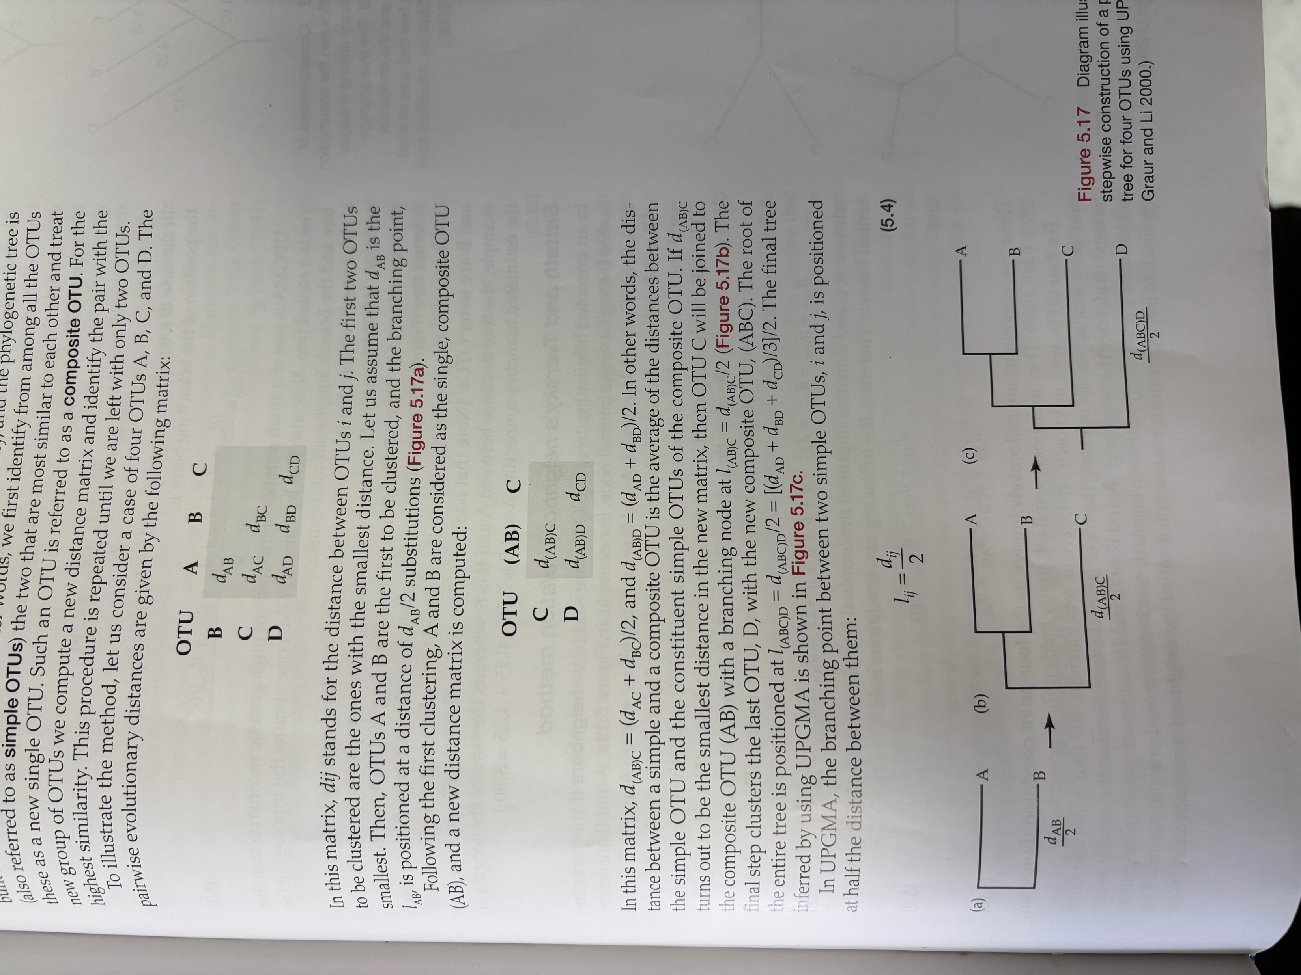
UPGMA
Assumption: evolution rates are constant
Sequentially clustering
→ Start with the most similar ones (least distant) → they are now one unit
Recalculate distance matrix
Add the next most similar one
Repeat until you are only left with 2 units

Slide 9
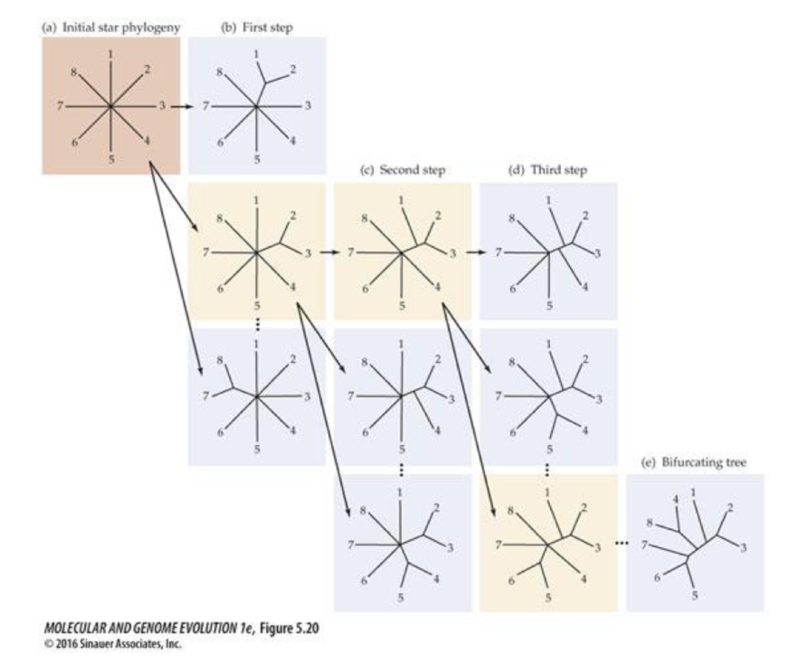
Neighbor-joining method
Finds the shortest (minimum evolution) tree → sequentually finding neighbors that minimze the total length of the tree.
Start with star → you add a branching and see how the total tree length is still the shortest.
Continued until all the internal branches are found.

Slide 10



Maximum parsimony
NOT a distance method
Identification of a toplogy that requires the smallest number of evolutionary changes (= nucleotide substitutions) to explain the observed differences.
= shortest set of pathways leading to the final tree.
You only look at variable sites
A | G | G | G | G | G | T
A | G | G | G | G | G | T
A | C | G | G | G | G | T
A | C | G | G | G | G | T

Slide 11
Friday – lecture
More about substitution models, and phylogenetic methods

